Slide 1
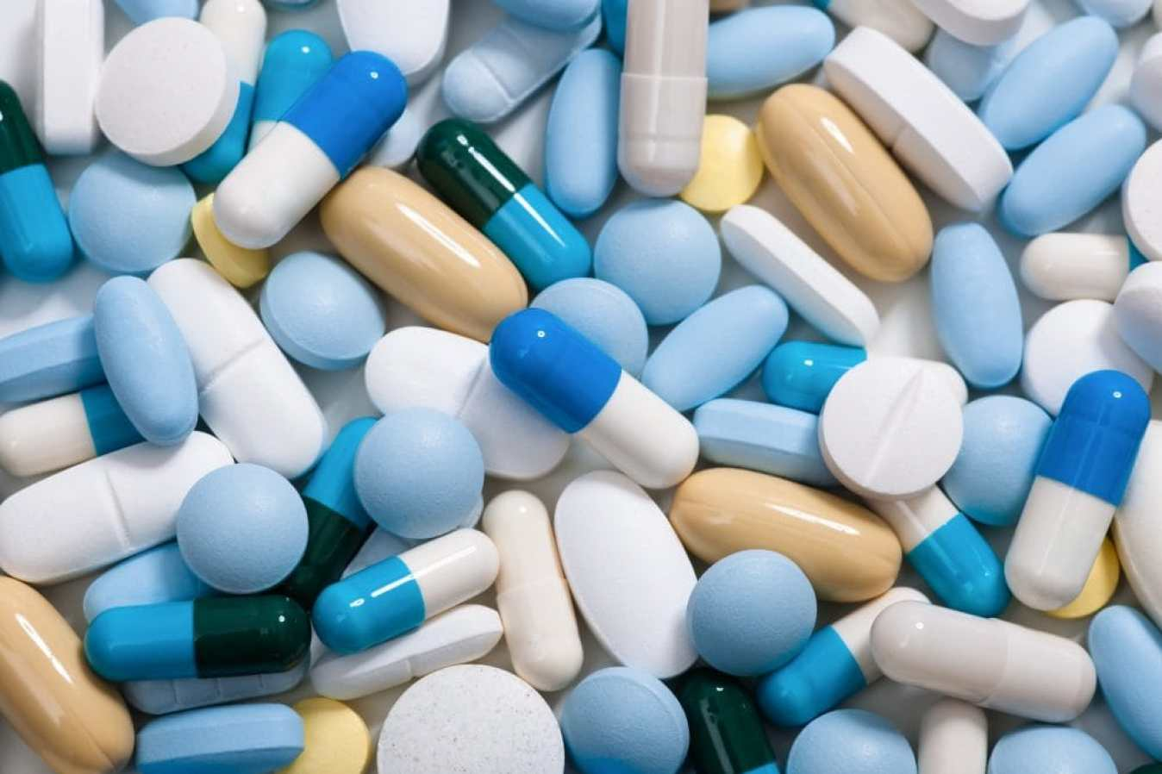
Sentiment Analysis of Drug review data
IST 736 TEXT MINING
PROFESSOR YINGYA LI
TEAM MEMBERS:
HARSHITA ASNANI | LAXMAN KUMAR | HITESH THADHANI

Slide 2
About the data
This data contains the reviews of different Drugs which are prescribed for different condition. The data also consists rating for different combination of drug and condition along with the count of users who found the review useful.
We have total 1,60,000 reviews with 3436 different drugs and 885 different conditions.
Data Attributes
uniqueID - Unique ID
drugName - Name of drug
condition - Name of condition
reviewPatient – review text
rating - 10 star patient rating
date - Date of review entry
usefulCount - Number of users who found review useful

Slide 3

Problem Statement -1
While buying drugs from a store, it is difficult to decide and chose a drug that would be most effective for a given condition. Since there are hundreds of alternative drugs present for a condition
Generating a overall rating for a drug per condition will help consumers to choose a better drug
This will be our Regression problem.

Slide 4
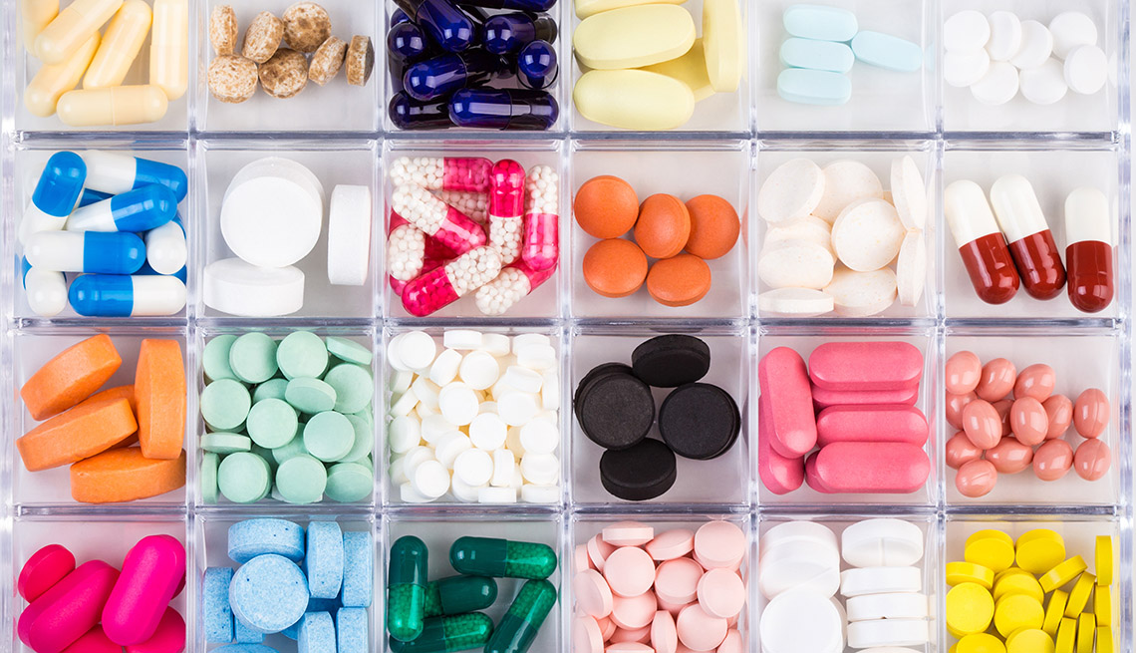
Problem Statement -2
Our second problem statement will be predicting the patient’s condition based on the drug consumed or bought by him
This will be our classification problem.

Slide 5

Problem Statement -3
What elements of a review make it more helpful to others? Which patients tend to have more negative reviews? Can you determine if a review is positive, neutral, or negative?
This will be our sentimental analysis problem

Slide 6
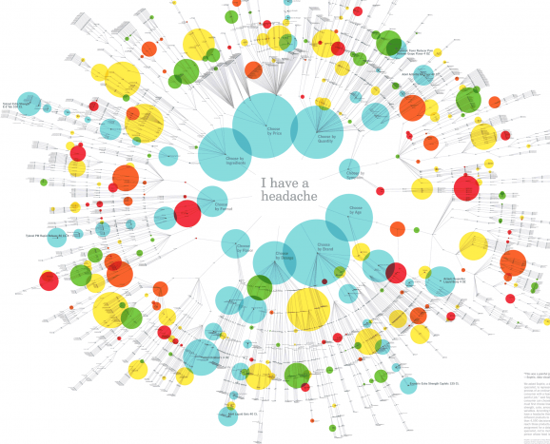
Problem Statement -4
What kind of drugs are there? What sorts of conditions do these patients have?
We will generate visualizations to solve this problems.

Slide 7

Thank you

